Slide 1
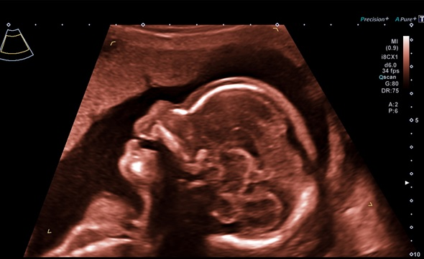
Scan findings in complete
fetal heart block
Wessex Fetal Medicine Unit
Princess Anne Hospital
Southampton

Slide 2
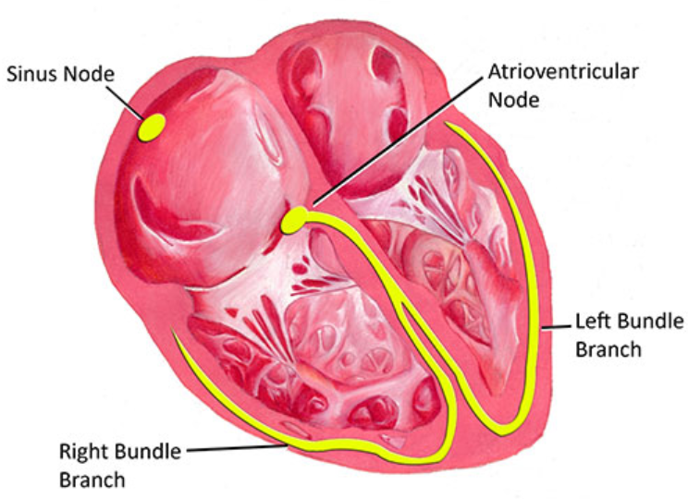
Pathology
Heart rate usually set by the pacemaker in the right atrium
Atria and ventricles are electrically disconnected except at the AV node which transmits pulsation: 1:1 transmission.
Ventricle rate = atrial

Slide 3
Pathology
Complete heart block occurs when the AV node is damaged so the ventricles beat at their own natural rhythm: in fetuses this is usually 50 to 60bpm
In fetuses with structurally normal hearts AV node damage is nearly always due to autoimmune antibodies (anti-Ro or anti-La)

Slide 4
Typical presentation
Complete heart block most commonly develops around 24 to 30 weeks.
Typical presentation: at routine midwifery check (often 28 weeks) with normally grown and active fetus FH heard to be <60bpm
On arrival at hospital FH continues at similar rate
This often results in emergency CS for “fetal distress” in very premature fetus with no steroid preparation, resulting in poor outcome

Slide 5
Actions to take
Stop. Think. Assess fetus. By the time of arrival at hospital after transfer from midwife antenatal visit the bradycardia will usually have continued for at least 30 minutes and if due to fetal distress the baby is unlikely to survive for this length of time
Scan: examine heart first and compare atrial and ventricular rates – see following slide
In complete heart block atrial rate will be normal (120-160bpm), but ventricular rate slow (50-60bpm)
Once heart checked note fetal activity, liquor and growth. All likely to be normal
DO NOT DELIVER – ask for urgent fetal medicine advice

Slide 6
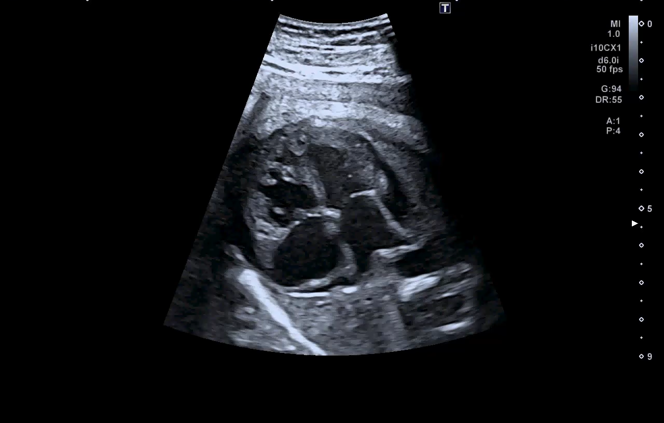
Ultrasound appearance
Slow ventricle rate
Normal atrial rate

Slide 7
Conclusion
All labour ward consultants or senior registrars should know and be able to identify the features of complete heart block to avoid inappropriate and damaging urgent premature delivery
If in doubt telephone fetal medicine for advice

