Slide 1
Psychological safety and patient safety for maternity care
Professor Suzette Woodward DSc, DProf, MSc, RGN, RSCN

Slide 2
Consider an experience of rudeness, or incivility that you have experienced, witnessed or tackled – list the reasons why you think this might have happened
3 MINS

Slide 3
Sharing
20 mins

Slide 4
Exploring your role in addressing the impact of incivility
Suzette
20 mins

Slide 5
There is a direct link between how we behave towards each other with improved patient experience and outcomes and staff experience and morale

Slide 6
Rudeness and incivility
Sneers, ignoring others, talking over someone, belittling, sharp tone, not listening, rolling eyes
Bullying
Intimidate, humiliate, coerce, torment

Slide 7
Based on a true story
For obvious reasons names, places and genders have been changed in order for them to be unrecognisable but the facts of the story are true

Slide 10
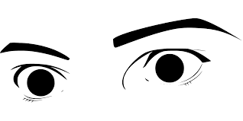

Slide 11
Initial response
Try to make sense of the situation
Reinterpret the event or confused about what constitutes appropriate behaviour
Feeling at least partial blame to the situation
Bargaining - ‘he / she was rude because of stress’

Slide 12
You try to think abut the potential reasons
Vulnerability
Background
Past experience
Gain power over others
Get things done
Get rid of people

Slide 13
Then you reduce your helping behaviours
Rudeness undermines mutual benefit
People who are being mistreated don’t help those who mistreat them and those associated with them and actively withdraw helpfulness
People reduce organisational commitment

Slide 15
The effects of rudeness and incivility ripples far beyond the people directly around you if not careful it can spiral out of control

Slide 17
Understand the difference between rudeness, civility and bullying and respond proportionately and appropriately to each
In an industry like healthcare that is totally reliant on people being able to adjust their performance, make decisions about complex issues and think quickly in order to keep patients safer… … these behaviours have a big negative impact
In order to work safely people need to be able to speak up, share, learn – how can they do this if they are silenced

Slide 18
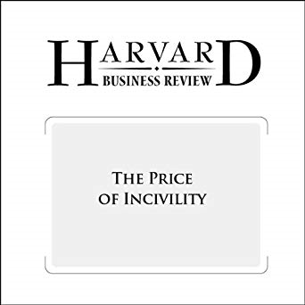
Even minor incivility can lead to..
an immediate loss of cognitive capacity
reduction in the quality and time of work
impacts on onlookers or bystanders
potentially ripple to impact on patients
civilitysaveslives.com @civilitysaves
When rudeness in teams turns deadly
Dr Chris Turner
TED talk
https://www.civilitysaveslives.com/videos

Slide 19
Discussion
All

