Slide 1
Role of the Educational Supervisor
Curriculum 2019 Training Day
18th October 2019

Slide 2
ES Cycle
Notes:
Who has seen this?
Monthly contacts – focus on frequency rather than length.
Changed in response to trainees that report regular contact with ES with high-quality feedback is beneficial.
Trainee –led – decide what want to discuss and document following.
Most will be face to face but could be via facetime etc
Some informal, others formal i.e. induction and pre-ARCP
ES better informed to make a global judgement
Central to ES cycle is the PDP
Talk through the year – induction, making a PDP, types of meetings
This should be interactive animation within e portfolio – is on elearning package

Slide 3
Within 2 weeks
Before meeting:
Consider CiP progress
Update PDP
Review handover
Review PDP
Review CiP progress
Discuss career
Pastoral concerns
Update PDP
Sign educational agreement

Slide 4
Notes:
How many of you use PDP currently?
What consultants use and FY use them
Interestingly that despite lots of emphasis put on the PDP, not easily found on eportfolio - Fay

Slide 5
Task specific
Use matrix
Updated whenever need for development identified
Short & long term
Can run across training years
Notes:
Going on continuously
Prepare the action
Create the action with objectives
Get outcome
Review
Cycle goes on throughout year
Matrix to identify essential tasks
Don’t have to have a PDP for each CiP
Cam be more individual rather than directly linked to curriculum ie time management

Slide 6
Monthly/ pro-rata
Good/ bad experiences
CiP progress
Review PDP
Wellbeing check
Notes:
Trainee led
Trainee complete CiP assessment following

Slide 7
Post ARCP
ARCP outcome?
Update PDP
Plans for outcomes running into next training year
Handover to next ES
Notes:
Follow up form ARCP – any actions?
May be difficult for Sept – need to book in early!
Handover for next ES – are there things that need concentrating on?

Slide 8
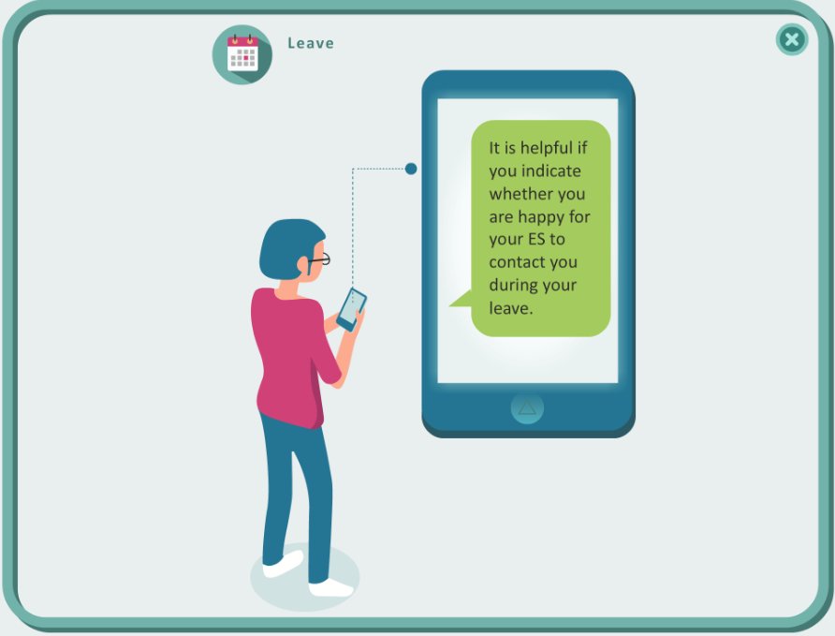
Notes:
Return to training meetings
Use to prompt what paperwork and prep needs to be done OOP/ mat eave/ planned sick leave
Is trainee happy for contact during leave?

Slide 9
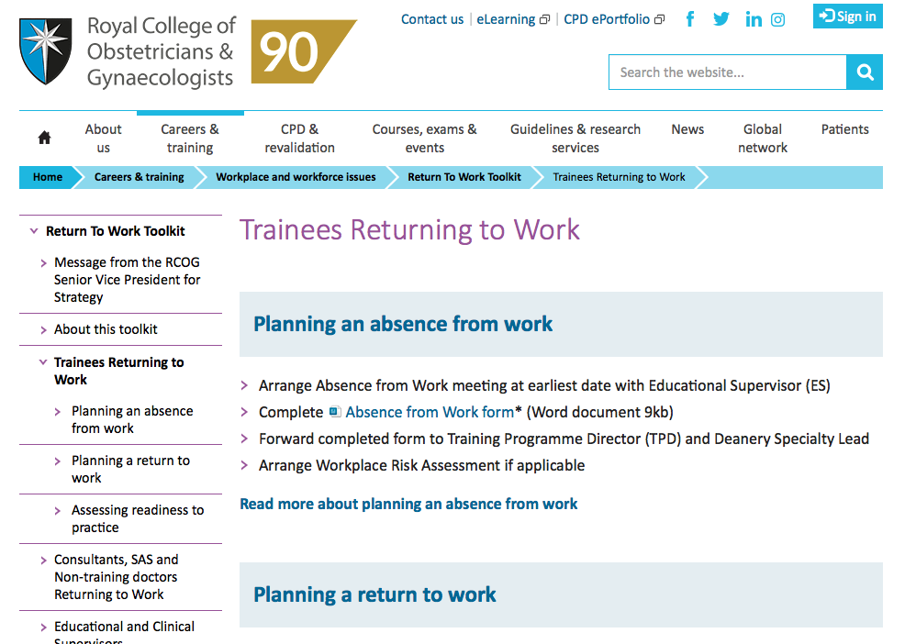

Slide 10
Any questions?
Notes:
Summary
Change but hopefully only in the documentation and handover
Focus on regular catch ups
This is a joint resource for both trainees and trainers

