Slide 1
Work Based assessments and other forms
Adam Naskretski

Slide 2
Work based assessments
A few changes to the forms
We need to complete the form before sending it
Can link each form to curriculum/CiP/ATSM
Can be done later
Can’t be self entered
Tickets expire after 7 days
College working on extending it

Slide 4
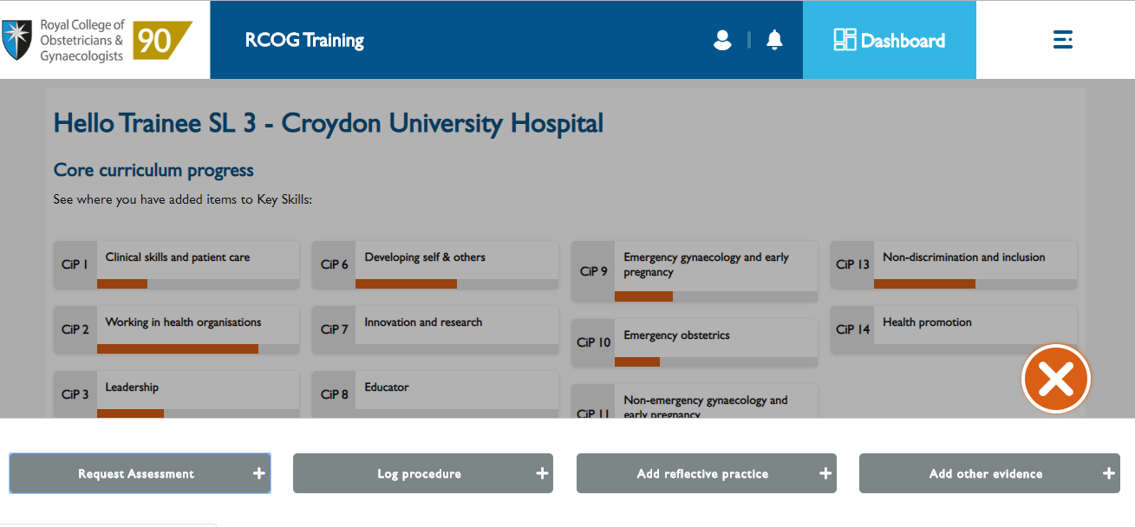

Slide 5
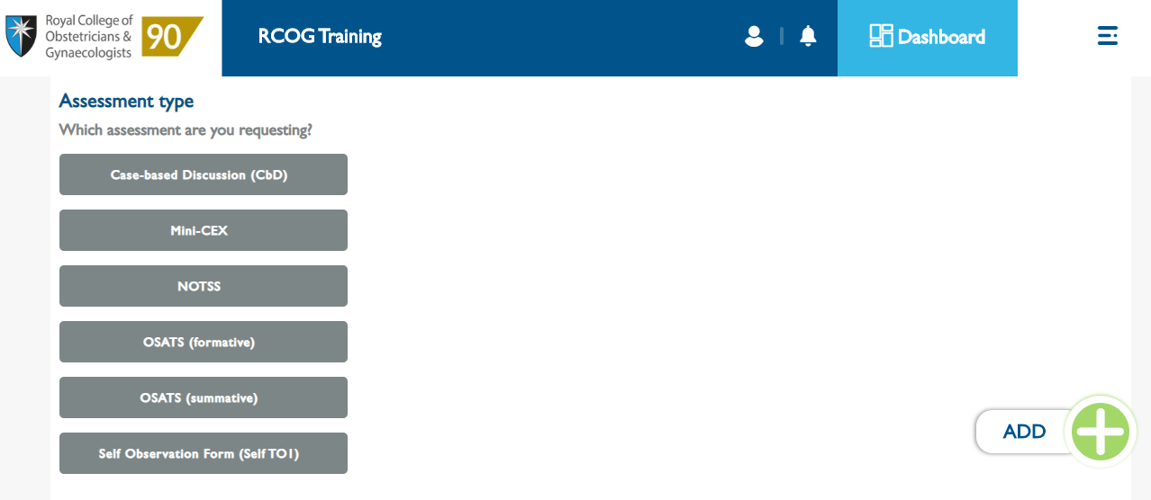

Slide 6
CBD and mini-cex
Same format for CBDs and Mini-Cexes
Complete the form before requesting the ticket
Describe the event
Trainee’s analysis
Trainee’s learning plan
Additional actions
Trainee’s reflection
No minimum number required
New category → Generic
Can link directly to curriculum CiPs
Key skill

Slide 7
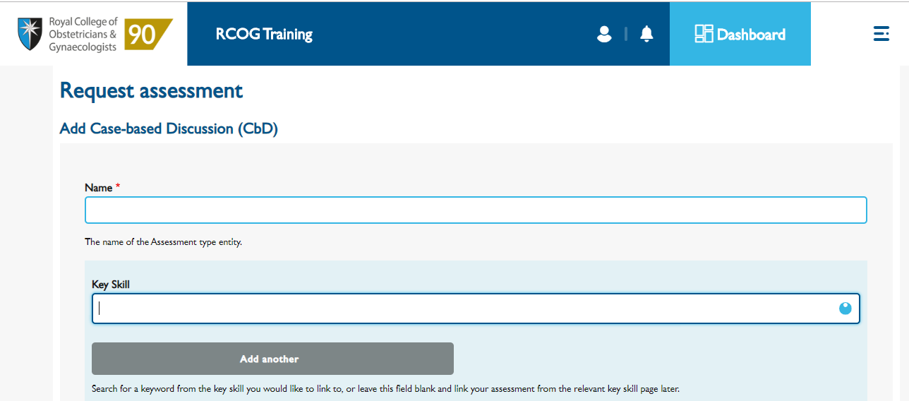
Can link immediately, stays even if form not filled (at least we tried!)

Slide 8
OSATS
List of procedures as per matrix/curriculum/ATSM requirements
Formatives not compulsory but encouraged
Summatives required
at least 3 as per matrix
Fill out the form before sending
Degree of difficulty
Encounter requested in advance
What went well
What could have gone better
Learning plan

Slide 9
NOTSS
Non-technical skills for surgeons
Framework to assess skills in:
Situation awareness
Decision making
Communication and Teamwork
Leadership
Compulsory for every trainee
No minimum number required
Examples:
Conducting WR
Managing LW
Running a theatre session

Slide 10
TO1
Areas of assessment:
Empathy and respect
Team Working
Verbal Communication skills
Accessibility and Conscientiousness
Record Keeping
Organisation and Thoroughness
Insight
Clinical Judgement
Options:
Major Concern
Some Concern
Satisfactory
Good
Excellent
Self Observation form
Required to complete a self assessment first
Assessors won’t see your self assessment
No need to repeat it if sending out more tickets
Need at least 10 assessors when first sending out
More can be added later on
Same principles apply
2 rounds
Must include a variety of professionals

Slide 12
Procedure Log
New format
Extensive list of procedures
Including US
Links to CiPs/ATSMs/curriculum
Can be viewed from dashboard
under Supporting material
→Procedure log

Slide 14
Reflections
Very similar format
No minimum number required
Can choose between: Obs/Gynae/Generic
Can be viewed from dashboard under Supporting material → Reflections

Slide 16
Adding other evidence
Allows adding files
Certificates
Audits
Debrief
Presentations etc.
Similar to Personal Library
Can be viewed from dashboard under Supporting material → Other evidence

Slide 17
Demonstration
CBD
Self Observation Form

Slide 18
Thank you
Questions?

